Slide 1

Team Sasha, Veena & William
July 18, 2019

Slide 2
Outline Calligraphy
What’s My Name?
Our Hypothesis
Background
Game of Thornes
Our Dataset
Data Cleaning & Data Analysis
Conclusion
Questions

Slide 3
What’s My Name?
Did the Game of Thrones (GOT) series impact naming of newborn babies in the USA?
If GOT series impacts naming of newborn babies in the USA, then there will be more GOT character names in the census from 1996 till now (in comparison to before GOT was published)
Notes:
Based on the best-selling book series "A Song of Ice and Fire" by George R.R. Martin, this sprawling HBO drama is set in a world where summers span several decades and winters can last a lifetime. From the scheming south and the savage eastern lands, to the frozen north and ancient Wall that protects the realm from the mysterious darkness beyond, the powerful families of the Seven Kingdoms are locked in a battle for the Iron Throne. This is a story of duplicity and treachery, nobility and honor, conquest and triumph. In the Game of Thrones, you either win or you die.

Slide 4
Background
“Game of Thrones”
- The first, “A Game of Thrones”, was published in 1996 by George Raymond Richard Martin also known as GRRM
- 17.4 million people watched episode 1, titled “Winterfell,” across multiple platforms, which includes HBOGo and HBO Now.
- 11.8 million viewers GOT watched on a regular basis
- New York (CNN Business) - Season eight of the series averaged 44.2 million viewers per episode when you account for delayed viewing.
- Viewership for the show is more impressive when you consider that HBO is a service that people have to specifically pay for. It is available in around 35 million households in the United States, or roughly a third of the number of homes that can see CBS, NBC and ABC.
(https://www.refinery29.com/en-us/2019/04/229944/game-of-thrones-viewership-ratings-season-8)
(https(://www.cnn.com/2019/05/20/media/game-of-thrones-finale-ratings/index.html)
(https://www.nbcnews.com/pop-culture/tv/game-thrones-premiere-sets-viewership-record-hbo-n995141)

Slide 5
Background
“Popular Baby Names”
Our dataset was created by using the Social Security Administration (SSA) dataset and contains all names from Social Security card applications for births that occurred in the United States.
This public dataset was created by the Social Security Administration and contains all names from Social Security card applications for births that occurred in the United States after 1879.
SSA provides only the top 1000 popular names through their datasets to provide and maintain an acceptable performance level on their servers. We have almost all names for researchers interested in naming trends.
All data are from a 100% sample of records on Social Security card applications.
To safeguard privacy, the Social Security Administration restricts names to those with at least 5 occurrence.
(https://www.ssa.gov/OACT/babynames/background.html)

Slide 6
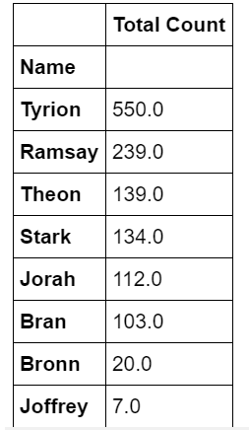
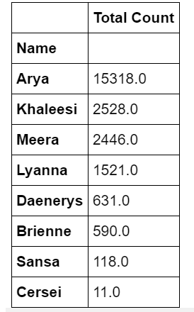
Data Cleaning & Data Analysis
# dependencies
import numpy as np
import pandas as pd
import matplotlib.pyplot as plt
import os
******
yob1991 = "DATA SET/yob1991.csv"
yob2018= "DATA SET/yob2018.csv"

Slide 7
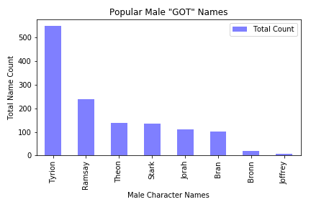
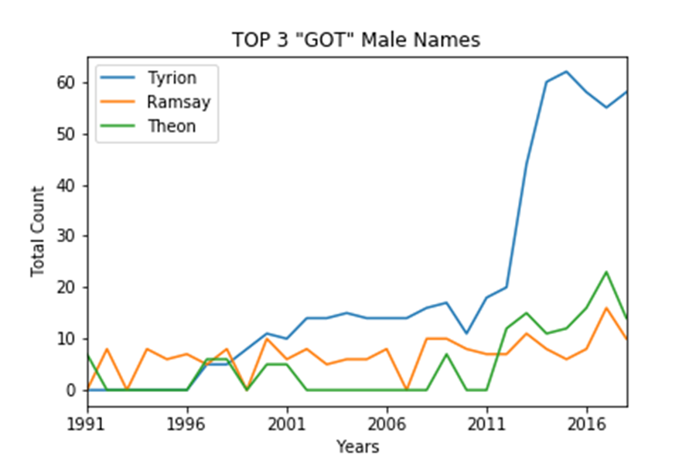
Data Cleaning & Data Analysis

Slide 8
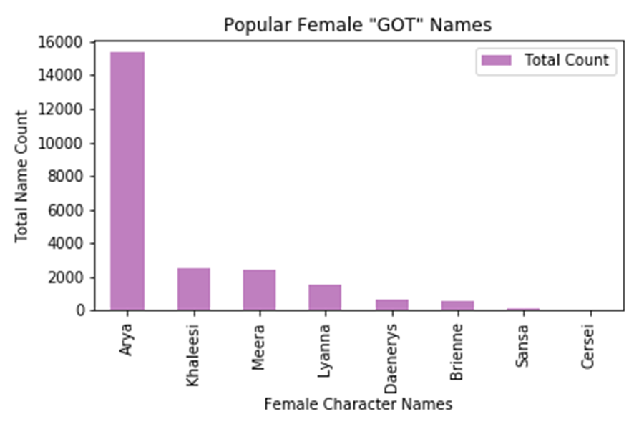
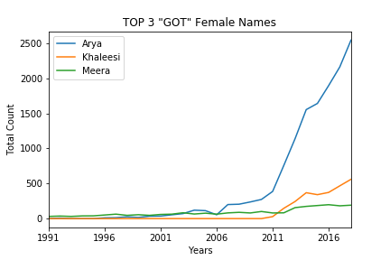
Data Cleaning & Data Analysis

Slide 9
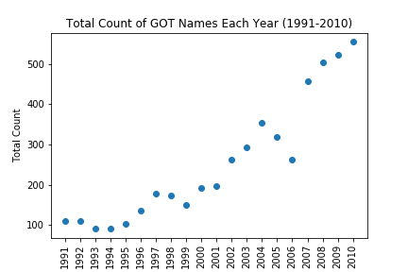
Data Cleaning & Data Analysis

Slide 10
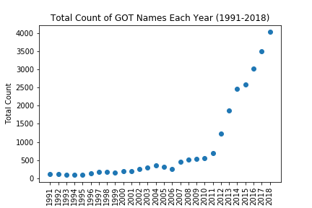
Data Cleaning & Data Analysis

Slide 11
Data Cleaning & Data Analysis

Slide 12
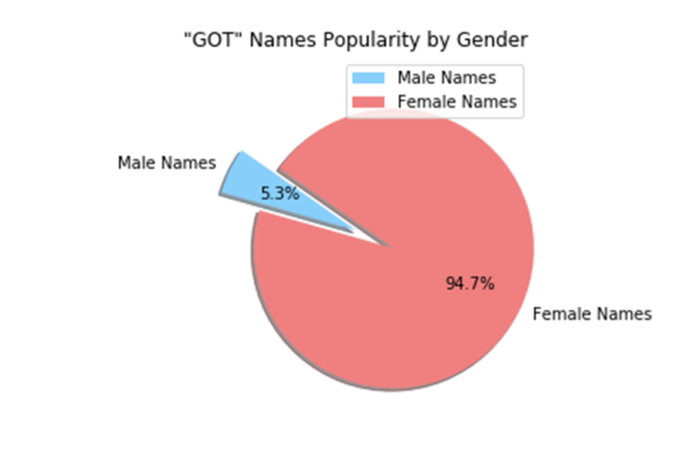
Conclusion
Future Data Analysis Work
Explore baby name data for each States
Explore where in each State the babies were born (Urban, Rural or Suburbs) and when (winter, spring, summer or fall)
Are GOT baby names more popular than Marvel comic book character names (e.g., Pepper, Loki, Hulk, etc.)
Notes:
Parker: 1,487 female, 4,346 male.
• Wade, 899 male.
• Natasha, 355 female.
• Pepper, 121 female, 7 male.
• Loki, 5 female, 91 male.
• Valkyrie, 63 female.
• Marvel, 21 female, 29 male

Slide 13
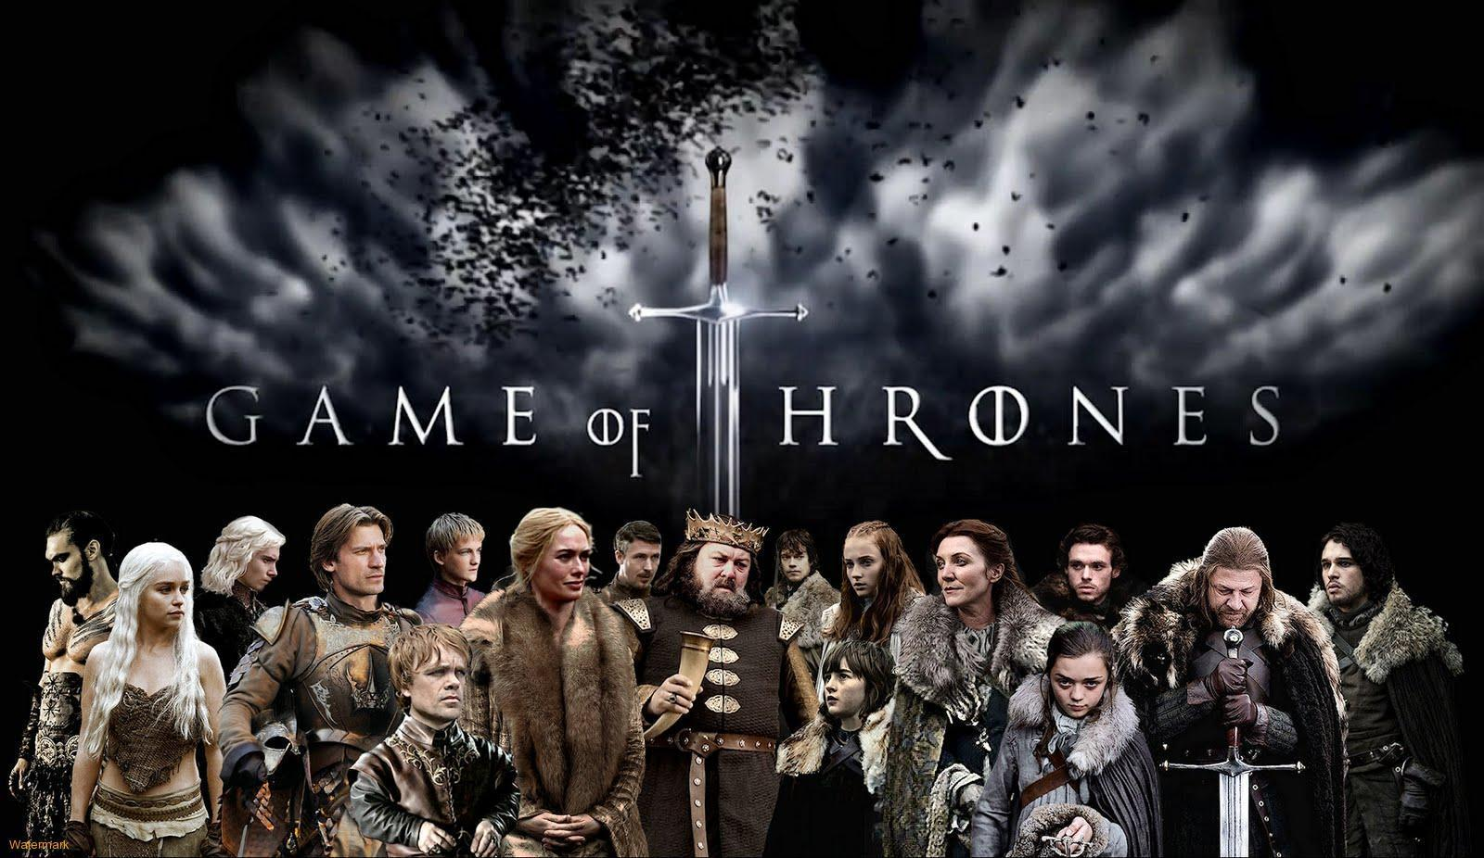
Questions

